Slide 1
Group formation in shared space
Yao LI
First supervisor: Prof. Monika Sester

Slide 2
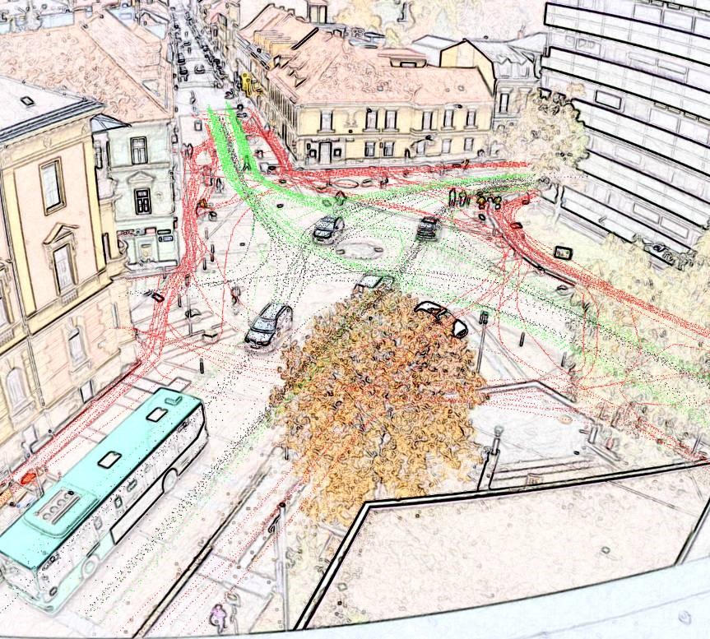
Introduction
Shared space
Urban design approach
No traffic sign/features
Expectation of designer
Creating a greater sense of uncertainty
Unclear priority
Drivers will reduce their speed
Reducing the dominance of vehicles/road casualty rates
Improving safety for other road users
http://www.styria-mobile.at/

Slide 3
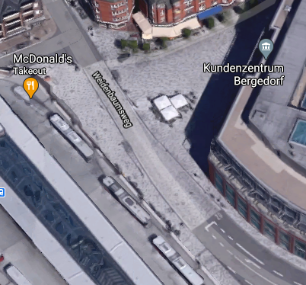
Introduction
Shared space
Urban design approach
No traffic sign/features
Expectation of designer
Creating a greater sense of uncertainty
Unclear priority
Drivers will reduce their speed
Reducing the dominance of vehicles/road casualty rates
Improving safety for other road users
However, there are still some problems left for shared space…
http://www.styria-mobile.at/
©2020 Google

Slide 4
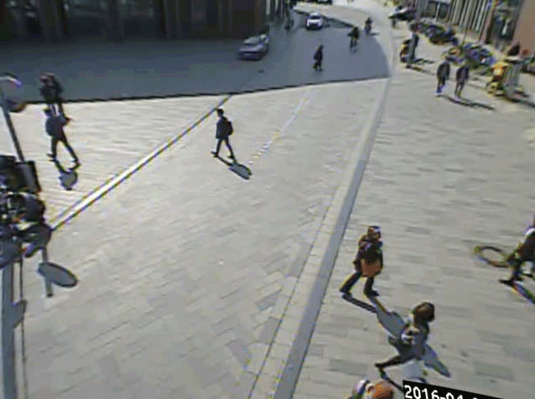
Motivation
Starting from a dataset collected from Hamburg… [Pascucci et al. 2017]
Forming groups will lead to a safer and more efficient traffic!

Slide 5


Problem statement
Q1. What is the definition of group in my research?
Groups are structured objects, formations of entities moving in a coordinated manner, whose members varies over time because targets can enter a scene, or disappear at random times. The groups can split, merge, can be relatively near to each other. What is typical for group formation is that they maintain certain pattern of motion. [Mihaylova L et al. 2014]
Q2. When/where shall the group form?
Small group question
Dealing with multiple groups with only a few components per group
Large group question
Dealing with a relative large number of constituents whose individual members cannot be easily distinguished, also referred as crowds or clusters
[Bazzani et al. 2012]

Slide 6

Problem statement
Q3. How large shall this group be?
Q4. When shall the group take actions (like crossing)?
Q5. How to maintain the coherence and persistence of a group during actions?
Waiting time
Group size
Group formation
Layer 1 Before taking action (coordination) Q2~Q4
Layer 2 During action (path finding) Q5

Slide 7



Objective
A centralized controller at shared space, with which all road users can pass the shared space (mixed traffic space) efficiently and safely.
Current position/speed/
Acceler-ation
etc.
Number of VRUs to cross/ waiting time
Willing to pass
Centralized controller
Collects and processes info
Assign priority and path
Vehicle approaching shared space
Virtual signal
VRUs
New speed/ reserved arrival time
Path/ crossing time slot
Show path

Slide 8
Cooperative intersection management
Similar as controller shown before, an intersection is a shared resource that a limited number of road users want to utilize at the same time, thus intersection occupation needs to be scheduled and coordinated. The process of CIM can be used as a reference.
Cooperative intersection management
Intersection modeling
Space and time discretization
Trajectory modeling
Traffic coordination methodologies
Centralized
Decentralized
[Chen et al. 2016]

Slide 9
Cooperative intersection management
Similar as controller shown before, an intersection is a shared resource that a limited number of road users want to utilize at the same time, thus intersection occupation needs to be scheduled and coordinated. The process of CIM can be used as a reference.
Cooperative intersection management
Intersection modeling
Traffic coordination methodologies
Space and time discretization
Trajectory modeling
Centralized
Decentralized
[Chen et al. 2016]

Slide 10
Cooperative shared space management
higher granularity
↓
more detail
↓
higher complexities
Space and Time Discretization
Trajectory Modeling
Traffic Coordination
Find safe pattern
cartoonstock.com
mathematical optimization
multi-agent systems

Slide 11
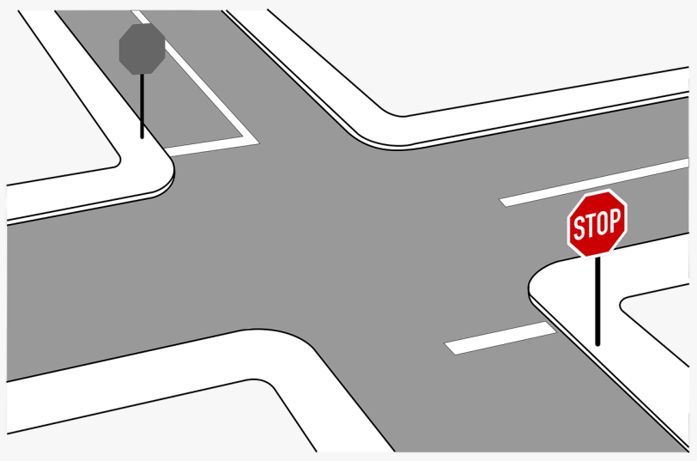
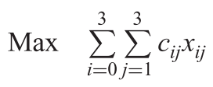
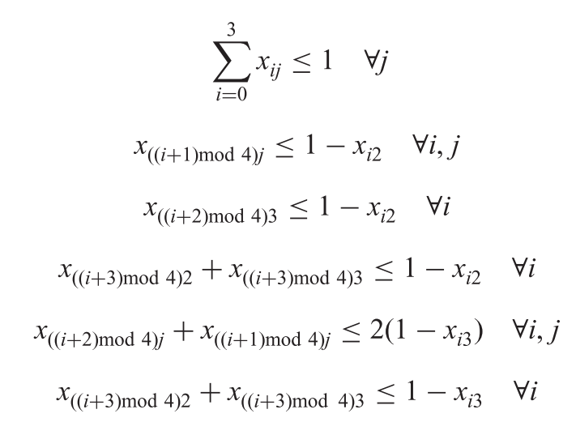
Option: Integer linear programming
Constrains
The OD data of all road users are known
The road users can communicate/follow the controller’s instructions
Sample example [Ghaffarian et al. 2012]
The defined ILP algorithm is:
Subjected to:
2
1
3
0
Figure by Dan Corag

Slide 12
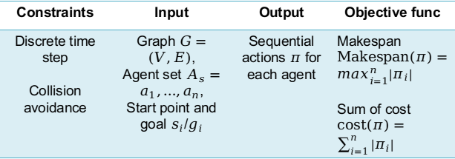
Multi-agent pathfinding (MAPF) problem
The classic MAPF
Online MAPF [Svancara et al. 2019]
While the agents execute the generated plan, a sequence of new agents appear on the map.
what happens when an agent reaches the goal?
What happens when a new agent appears in its initial location?
Constraints | Input | Output | Objective func
Discrete time step Collision avoidance | Graph$G=\left(V,E\right)$, Agent set $A_{s}=a_{1},…,a_{n}$, Start point and goal $s_{i}$/$g_{i}$ | Sequential actions $π$ for each agent | Makespan$Makespan\left(π\right)=\max_{i=1}^{n}\left|π_{i}\right|$ Sum of cost $cost(π)=\sum_{i=1}^{n}{\left|π_{i}\right|}$
SG
G
As
How to combine group information
with MAPF?

Slide 13
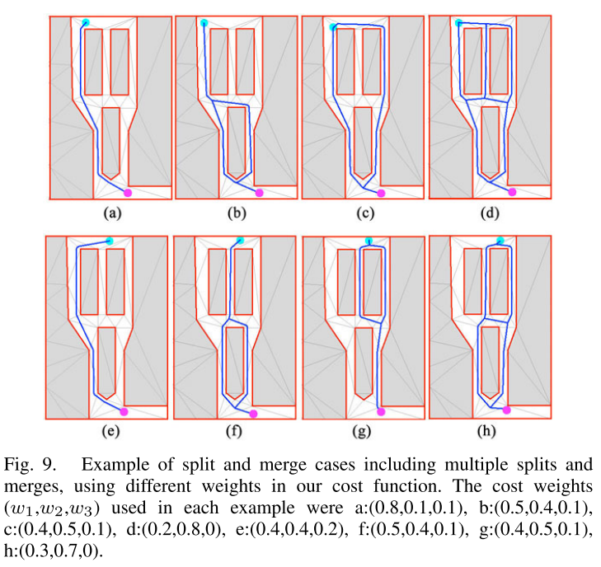
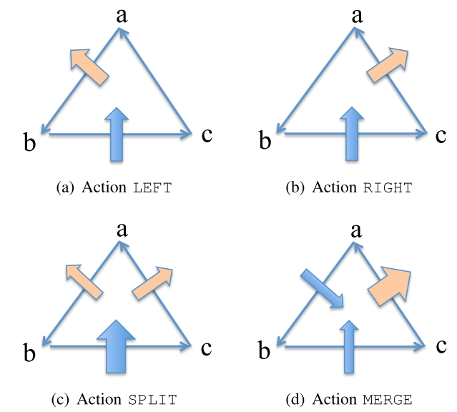
Option: Path finding for
coherent and persistent groups
The efficiency of the group search is determined by three factors: path length, deformation minimization, and spitting minimization. [T. Huang 2014]
Evaluation function (accumulate the respective costs from the initial to the goal state):

Slide 14
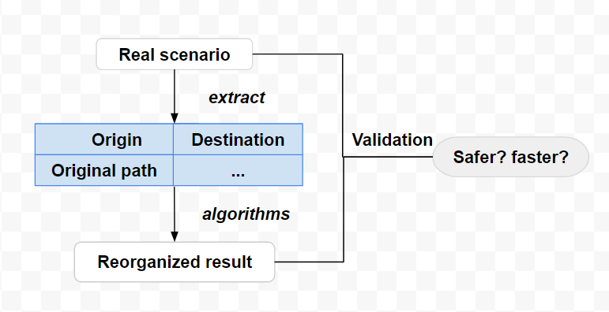
Workflow
Dataset
The time needed for all road users to pass through
Generated trajectories

Slide 15
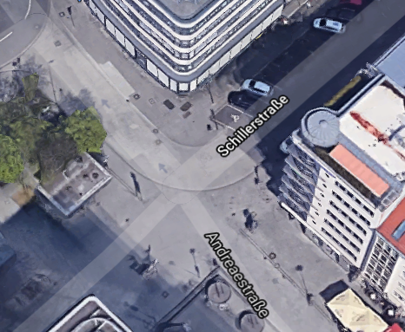
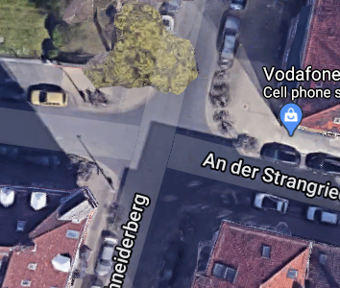
Datasets
Test dataset
1. Hamburg dataset from MODIS project ✔
2. Data recorded by Mariana
3. Vehicle-Crowd Interaction (VCI) - DUT Dataset
4. Searching for other datasets…
Acquire own data
Candidate 1: a junction near Hannover Hbf
Candidate 2: a junction near IKG

Slide 16

Open questions
For a centralized system, the rapidly increasing number of agents will cause complexity problems. Is it feasible to use an distributed paradigm for multi-agent path finding in shared space?
Shared space has a variety of designs. How to deal with the generalization problem?

Slide 17
Schedule
2020 |  |  |  |  |  |  | 2021 |  |  |  |  |  |  |  |  |  |  |  | 2022
06 | 07 | 08 | 09 | 10 | 11 | 12 | 01 | 02 | 03 | 04 | 05 | 06 | 07 | 08 | 09 | 10 | 11 | 12 |  | 01 | 02 | 03 | 04 | 05
Literature review/research questions
Klausurworkshop
Next steps (~6 months):
• Complete literature research and write the proposal
• Start implementation sample mode on test data
Expose
Case study
Knowledge study
Abstract submission, ISPRS
Data acquisition (if need)
Algorithm development
Experiments
Klausurworkshop
Evaluation
Thesis writing…

Slide 18
Reference
Forsyth DR. Group dynamics. Wadsworth/Cengage Learning; 2010.
Mihaylova, Lyudmila & Carmi, Avishy & Septier, François & Gning, A. & Pang, Sze Kim & Godsill, S.J.. (2014). Overview of Bayesian sequential Monte Carlo methods for group and extended object tracking. Digital Signal Processing. 25.
L. Bazzani, M. Cristani and V. Murino, "Decentralized particle filter for joint individual-group tracking," 2012 IEEE Conference on Computer Vision and Pattern Recognition, Providence, RI, 2012, pp. 1886-1893, doi: 10.1109/CVPR.2012.6247888.
T. Huang, M. Kapadia, N. I. Badler and M. Kallmann, "Path planning for coherent and persistent groups," 2014 IEEE International Conference on Robotics and Automation (ICRA), Hong Kong, 2014, pp. 1652-1659, doi: 10.1109/ICRA.2014.6907073.
Pascucci, Federico & Rinke, N. & Timmermann, Chris & Berkhahn, V. & Friedrich, Bernhard. (2017). A discrete choice model for solving conflict situations between pedestrians and vehicles in shared space.

Slide 19
Reference
H. Ghaffarian, M. Fathy and M. Soryani, "Vehicular ad hoc networks enabled traffic controller for removing traffic lights in isolated intersections based on integer linear programming," in IET Intelligent Transport Systems, vol. 6, no. 2, pp. 115-123, June 2012, doi: 10.1049/iet-its.2010.0207.
L. Chen and C. Englund, "Cooperative Intersection Management: A Survey," in IEEE Transactions on Intelligent Transportation Systems, vol. 17, no. 2, pp. 570-586, Feb. 2016, doi: 10.1109/TITS.2015.2471812.
J. Svancara, M. Vlk, R. Stern, D. Atzmon and R. Bartak. Online Multi-Agent Pathfinding. In Proceedings of the AAAI Conference on Artificial Intelligence (AAAI), 2019.

Slide 20

Thank you for attention!
Questions & Comments?
iconninja.com/

Slide 21
Backup slides

Slide 22
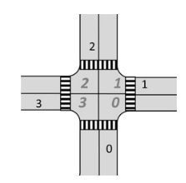
ILP Example
Safe driving pattern:
All vehicle cannot enter from same lane at the same time;
All vehicle cannot leave from same lane at the same time;
The trajectories of any two vehicles cannot cut each other at the same phase.
For a single vehicle, its driven directions can be calculated by MOD() function. Assuming the vehicle comes from i and leave from j, then:
Right turn: i
Straight forward: i, mod(i+1,4)
Left turn: i, mod(i+1,4), mod(i+2,4)
The aim is maximum the traffic flow, then apply the safe pattern constrains as the left conditions.

Slide 23
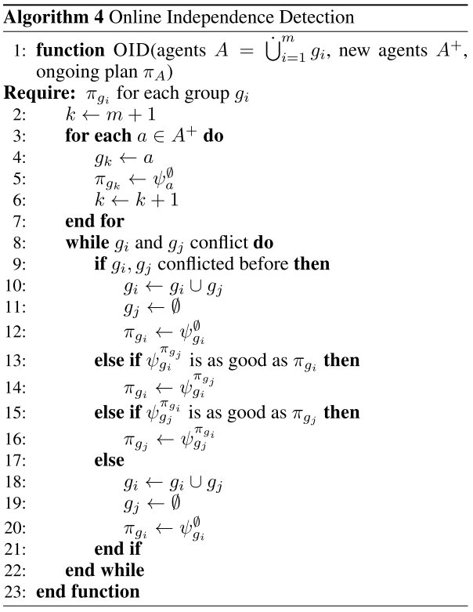
Online multi-agent path planning example
The main idea of OID is very similar: allow the new agents to plan while ignoring the other agents. If there is a conflict with the plan of an already planned agent, then we merge the groups of conflicting agents and plan for them altogether (again disregarding the other agents). This is iterated until there are no conflicts anymore. This adaptation of ID to online MAPF, however, may return plans that are not snapshot optimal. The reason is that an online MAPF algorithm is called multiple times, whenever new agents appear.
Therefore, a modified algorithm is shown on the right side.

Slide 24
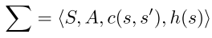
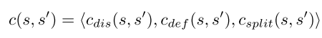
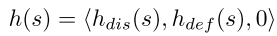
Path finding Example
The environment is divided into a triangulation-based navigation mesh.
A group is informally defined as a set of agents, satisfying collective spatial and temporal constraints while trying to achieve a common goal.
Group coherence is modeled by deformation cost to preserve the group desired shape, while group persistence is modeled by determining split and merge conditions,

Slide 25
Group tracking
The difference between group tracking and group detection [Bazzani et al. 2012]
The objective of group detection is to find collection of people who share certain aspects, interact with one another, accept rights and obligations as members of the group and share a common identity. To this end, we aim to investigate novel models and technologies that embeds notions of social psychology into computer vision techniques, offering a novel research perspective for the video surveillance community.
On the other hand, group tracking consists in following tight formations of individuals while they are walking or interacting. One of the major difficulties of group tracking lies in the high variability of the group entity: splitting, merging, initialization and deletion are frequent events that characterize the life of a group, and that are usually modeled by heuristic rules, yielding to a scarce generalization.
How to track a small group?
Tracking small groups
Standard Bayesian tracking
Joint estimation of objects’ states and group structure
Index for group affiliations / Transition probability between group structures
Graphical representation / Evolution models for the group structure
The maximum number of objects is known: Existence variable for each object
Random number of objects: Random finite set of objects/Markov random fields and MCMC

